Slide 1
Example: Message Board back-end
MERN Stack | Creating The Server Project | WEB API
Notes:
Welcome to our lecture on example of message board back-end. In this lecture we will go through what is MERN stack, how to create server project and what are WEB API. Let’s start the video lecture.

Slide 2
MERN Stack
MERN stack: MongoDB, Express, React, and Node.
React handles the UI and fetches data via a web API.
Express processes API requests and responses.
MongoDB stores app data in a document database.
Notes:
This project is built using a modern development framework that combines multiple technologies to create a full-stack application. The interface is responsible for displaying content and interacting with data. The system processes requests and manages responses, while the database stores all necessary information. Together, these components ensure smooth application functionality.

Slide 3
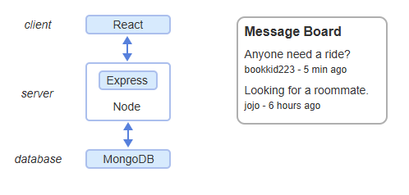
Example
Notes:
This diagram illustrates how different parts of the system work together. The interface allows users to interact with the application, sending requests to the system, which processes them and communicates with the database. The database stores and retrieves information, ensuring that messages are displayed and updated in real time, creating a seamless user experience.

Slide 4
Creating The Server Project
Node + Express handle API requests for the server.
Mongoose manages interactions with MongoDB.
Setup involves creating a Node project and installing dependencies.
Notes:
Now that we have seen how the front-end connects with the system, let’s move on to setting up the back-end. The system is responsible for handling requests, processing data, and interacting with storage. A structured approach ensures smooth communication between different parts of the application. The setup process involves creating the environment and installing necessary tools.

Slide 5
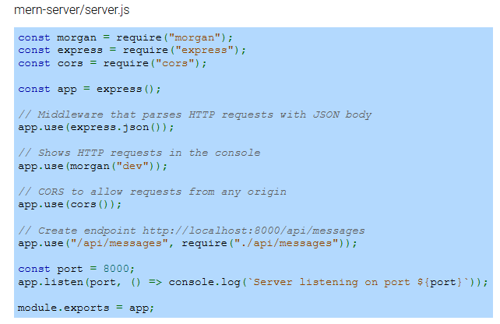
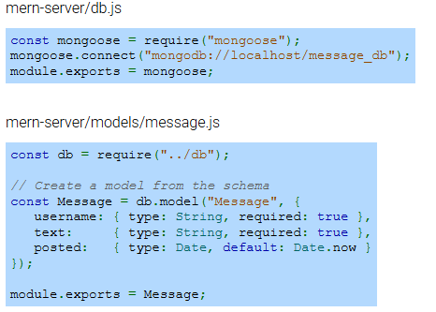
Example
Notes:
Now that we have introduced the back-end setup, let’s look at how the system is structured. The server processes requests, manages connections, and handles data storage. It listens for incoming interactions and ensures that responses are sent correctly. The system is designed with organized components, making it easier to manage data flow and maintain functionality.

Slide 6
Web API
app.use() routes /api/messages requests to messages.js.
messages.js defines the RESTful web API functions.
Start server with npm start to process API requests.
Notes:
Now that we have set up the back-end, let’s explore how the system processes requests. The server routes interactions to the appropriate logic, ensuring that data is handled efficiently. A structured setup allows the system to manage interactions dynamically. Once everything is configured, the server starts processing requests, enabling seamless communication between components.

Slide 7
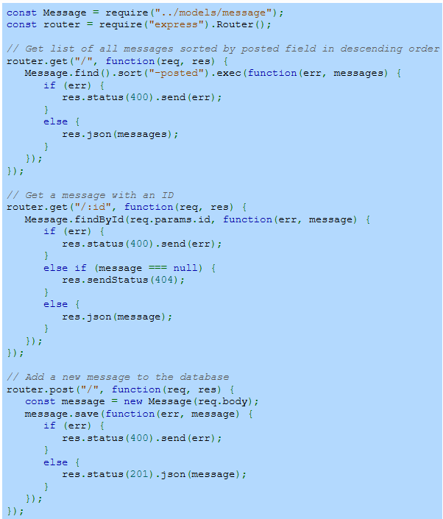
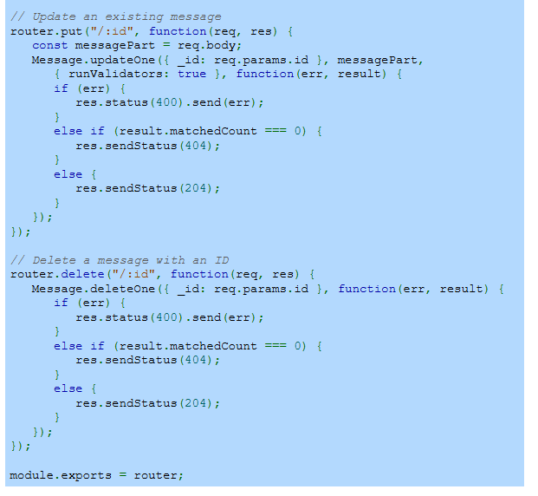
Example
Notes:
Now that we understand how the server processes requests, let’s look at how different operations are handled. The system retrieves, adds, updates, and removes data by responding to specific interactions. Each request is directed to the appropriate logic, ensuring data consistency and accuracy. This structured approach allows for efficient communication between the system and the database.

